Slide 1
I Found a Thing and You Can (Should) Too: ISP's Unauthenticated SOAP Service = Find (almost) All the Things!
Nick Popovich
@pipefish_

Slide 2
TL;DR
Used ISP’s own software to identify a flaw that allowed me to associate wireless SSID’s with public IP addresses, and gather wireless encryption keys, among other things.

Slide 3
About Me

Slide 4
Background
Penetration Tester for Sunera, LLC
Background in Military, DoD, financial, and retail sectors as a consultant and employee (both offense and defense)
Father (of two)
Husband (to one)
Suffers from “Curious Hermit Syndrome”
I need a non-technical hobby… please see me with suggestions!
Veteran

Slide 5
The Point
SOHO gear/apps sometimes overlooked.
Encourage research.
Talk about what I think was cool tinkering.
Go over my disclosure experience and lessons learned.

Slide 6
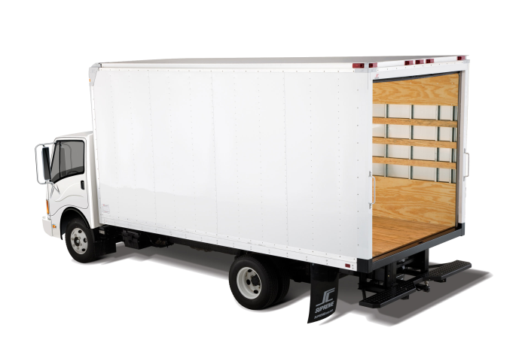
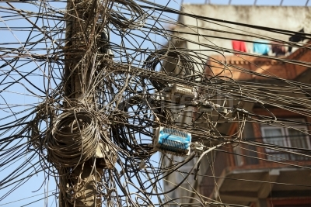

Story Time
I moved
Transferred my ISP services
ISP tech came for visit
put this in your slot…

Slide 7


Slide 8
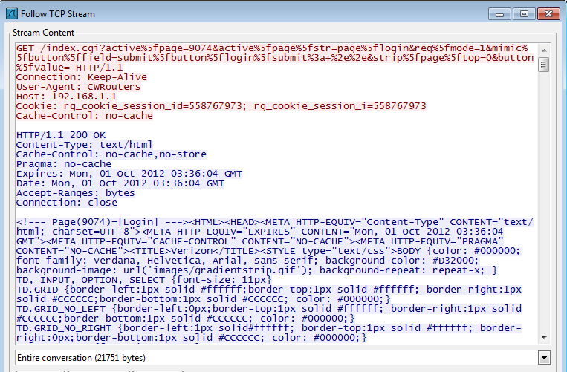
Watching the traffic in Wireshark raised more questions

Slide 9
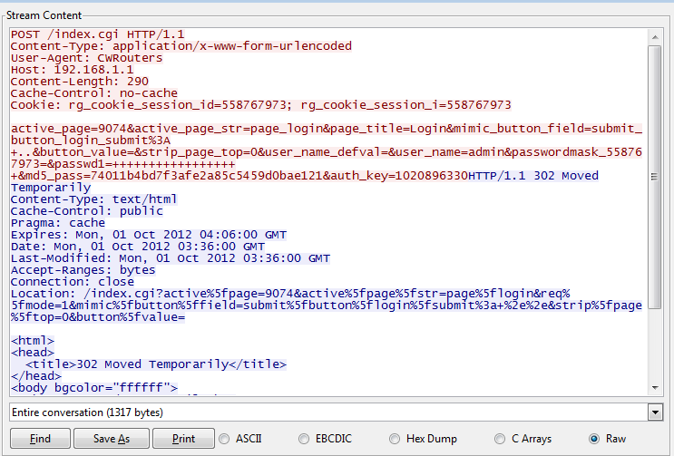
Wut?

Slide 10
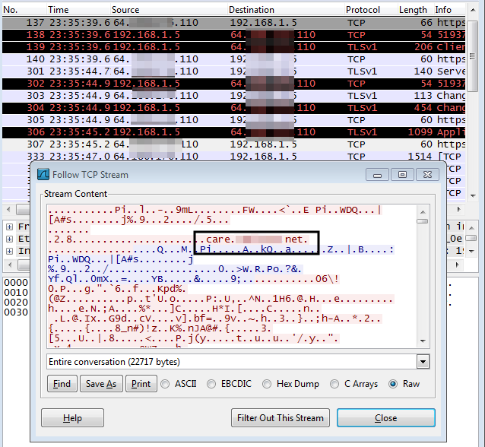
What’s This?

Slide 11
Proxify
I wanted to see the application’s traffic but it was encrypted, wireshark was not the way.
Proxified all connections from VM to pass through burp. (http://www.proxifier.com/ -> trial)
Installed Burp CA on VM
Configured Burp to use SSL cert with the name of the host I wanted to look into
Set Burp proxy to invisible (important!)

Slide 12
Invisible Proxy Settings
This was crucial, and simple. But I didn’t know it at the time.
First Google result for “invisible proxying” results in a blog post from PortSwigger. http://blog.portswigger.net/2008/11/mobp-invisible-proxying.html
From PortSwigger blog:
A proxy-style request looks like this:
GET http://myapp.com/foo.php HTTP/1.1
Host: myapp.com
A non-proxy request looks like this:
GET /foo.php HTTP/1.1
Host: myapp.com
HTTP Proxies do not look at the HTTP HOST header to determine the host to send the request to.
Setting the proxy to “invisible” will enable Burp to deal with non-proxy aware applications being forced through it.

Slide 13
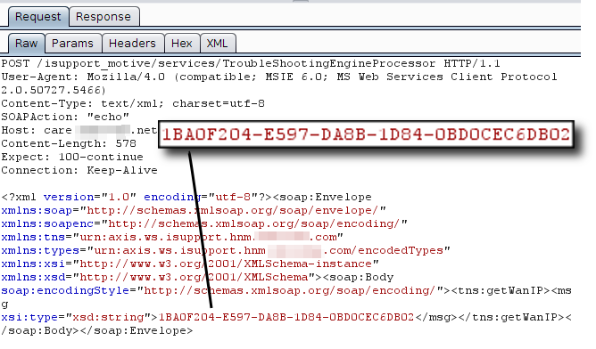
Response to this SOAP “echo” is simply my WAN IP. Notice
the GUID looking string…

Slide 14
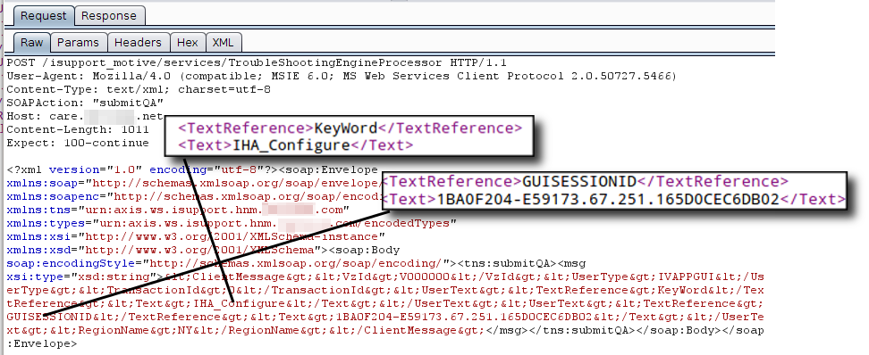
GUISESSIONID looks familiar, but has my WAN IP in the middle.
Response doesn’t have anything cool in it.

Slide 15
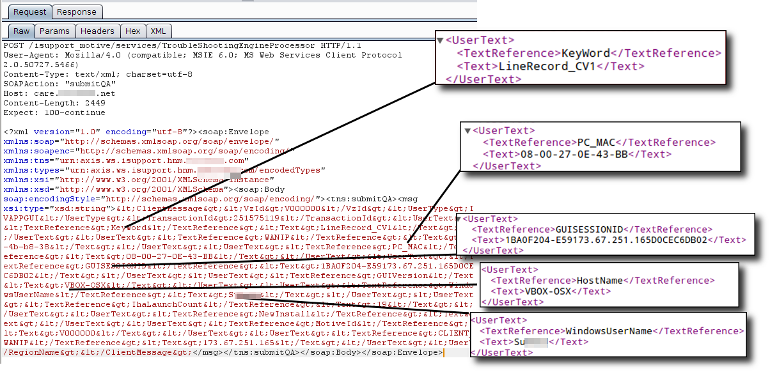
A little annoyed at the data I’M sending to ISP… Privacy hackles are up a bit.

Slide 16
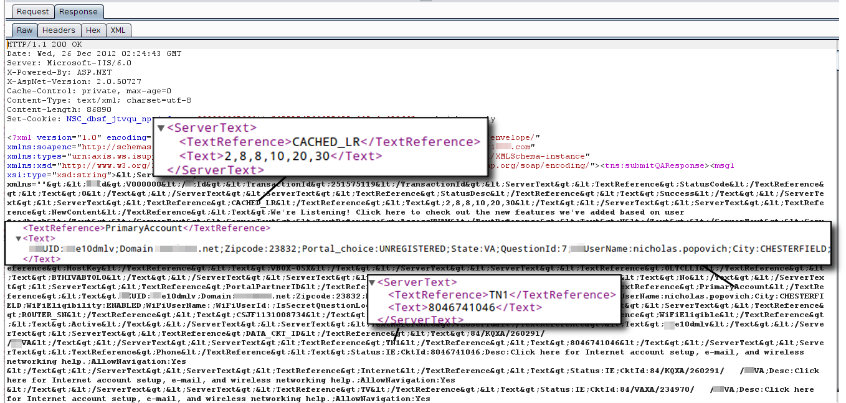
Response contained my zip code, my state, my city and my ISP username
(which happened to be first.last)

Slide 17
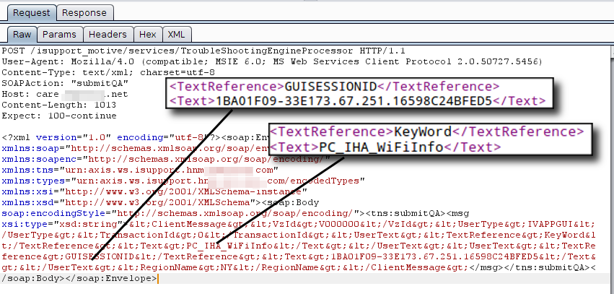
This is the POST that lead to a real “oh sh**” moment.
Take note this POST only sends the GUISESSIONID and the keyword.

Slide 18
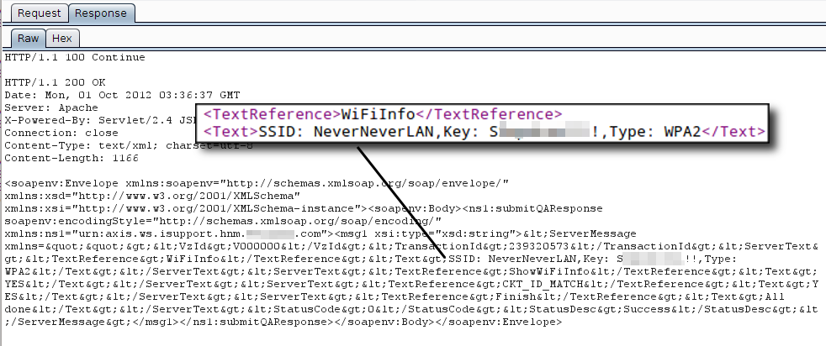
The response contained my SSID and my WPA2 PSK. Keep in mind
this response came from an Internet IP, not my local router.
Rinse and repeat; I used repeater and sent the same request and
received the same response every time. But it was only my data…

Slide 19
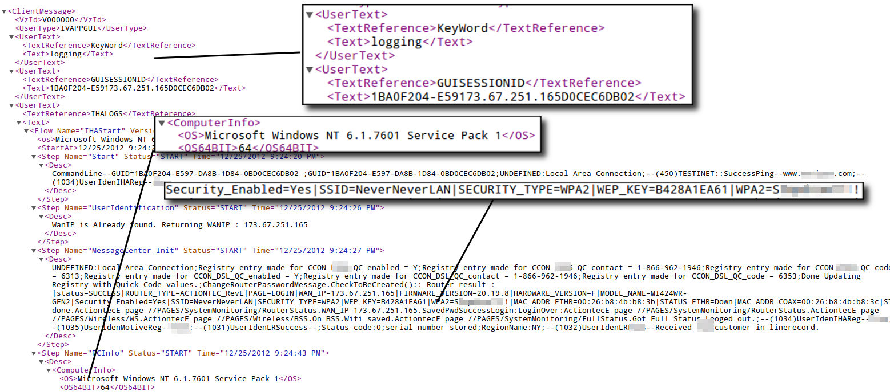
ISP Logs All The Things
These are formatted snips from the requests – too much data to show original request. This
is data within a POST from my machine to the ISP Internet IP address.

Slide 20
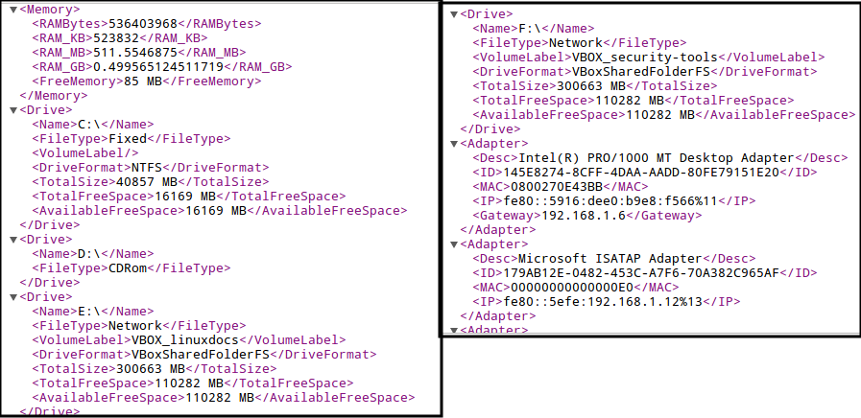
Memory on my machine, as well as disk space and drive info
(including mapped network drives).

Slide 21
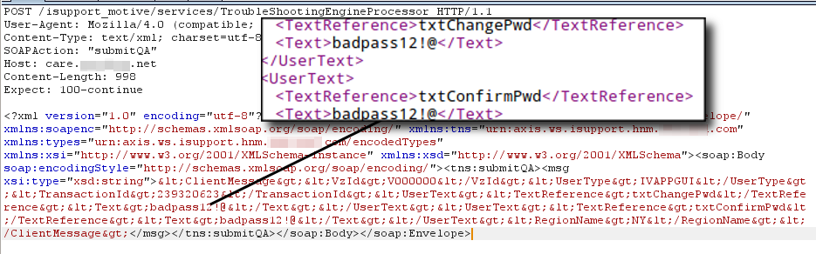
Change Router Pass

Slide 22


Slide 23
Curious (Selfish Phase)
At this point I’m only thinking about myself, and I’m a bit peeved.
Why did my ISP have/need my:
SSID name
SSID password (pre-shared key)
Windows username
Computer MAC address
Router password

Slide 24
Curious (Info Disclosure?)
What was used as authentication for this information? It wasn’t cookies, I checked.
Must be some secret sauce tied to my line or circuit ID… yeah it has to be secure/authenticated.
I wonder if I can see anyone else’s data like this? Nah…

Slide 25

I want moar infoz… to the SOAP!
I played with all of the features of the software, so that I could better understand its logic.

Slide 26
Watched and Listened
Process Hacker
Watched what files and registry keys were accessed, changed, modified, etc.
Burp
Continued to monitor all HTTP requests as I used the software. Started to find a lot of “keywords” sent to the service.

Slide 27
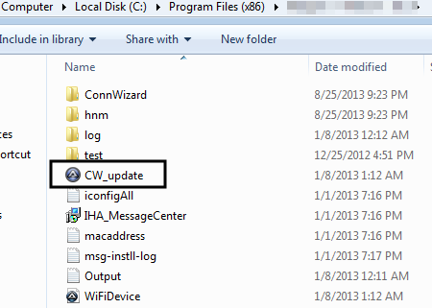
Discovered AutoIT Binary

Slide 28

“Reversed” AutoIT Binary
Not really, ran app called MyEXEtoAut.
Trivial to get source of AutoIT Binaries unless specific steps have been taken to make it harder.

Slide 29
The Accident
Accidently tested theory that GUISESSIONID was randomly generated value that simply needed to conform to a certain format.
Also confirmed no other mechanism was used for authentication.
Pulled some info that I shouldn’t have had access to, by accident (seriously!)

Slide 30
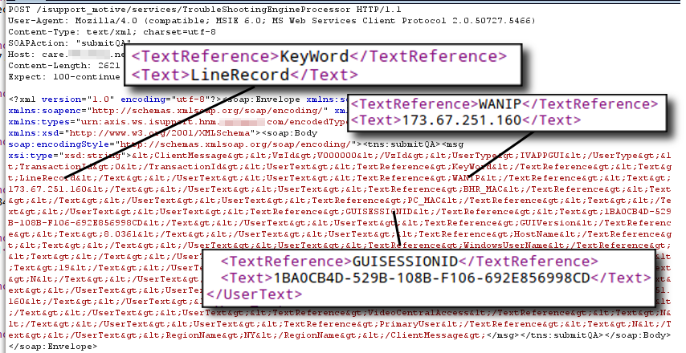
Oops

Slide 31
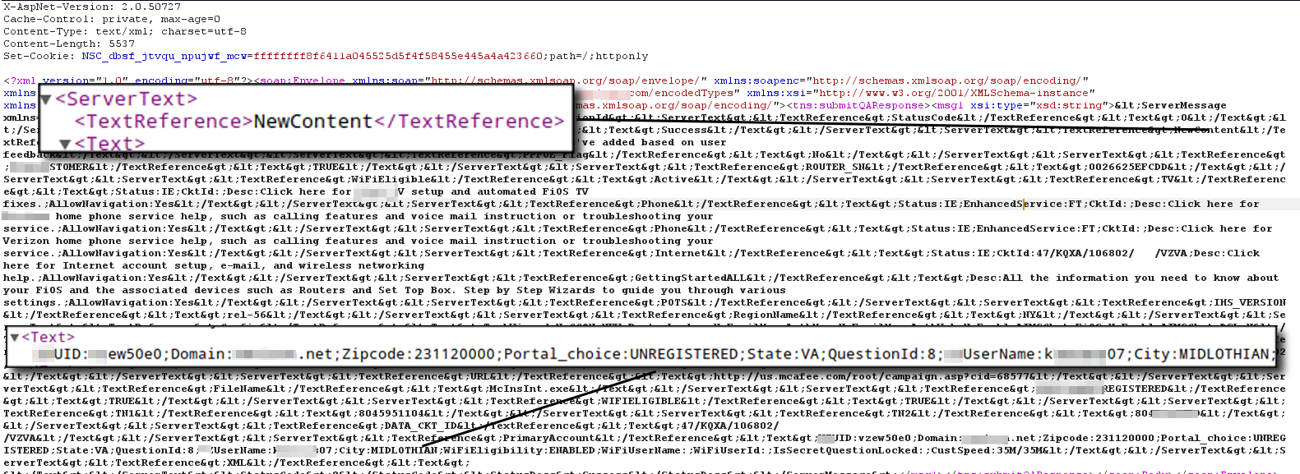
Oops!

Slide 32
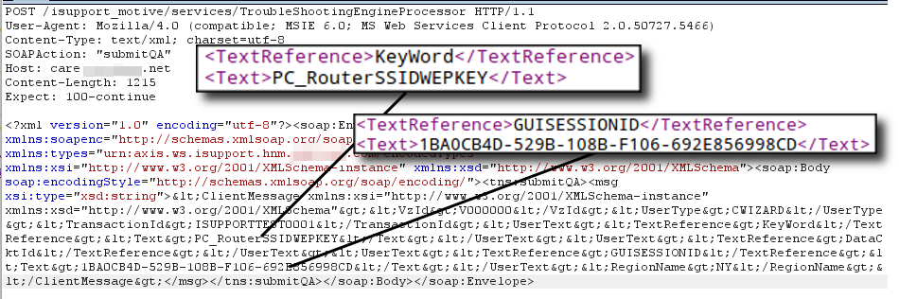
Coup de Grace

Slide 33
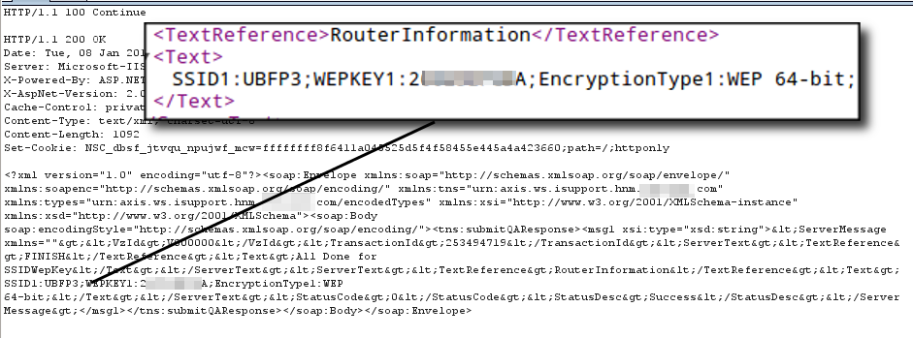
Some cat’s SSID and Key

Slide 34
Now What?
I want to tell ISP… but
Will I get in trouble? (thoughts of Weev danced through my head)
Will they care?
What if they don’t fix it, what then?
Sat on it for awhile while I thought it through
Decided to approach as a concerned customer

Slide 35
The Disclosure
Tough to find right POC at first.
When I did reaction was FAST.
Focused on professionalism/tact.
In this case the ISP was very appreciative.
Fixed the issue within a few days after some back and forth.
Gave me mad props and a discount on service (which was nice).

Slide 36
Research Summary
Note: This is based only on what I observed during my research.
Those affected:
Entities using ISP provided SOHO router, that had run this agent application.
What was the fix?
I could only confirm that I could no longer pull others’ info without authentication.
The data is still being sent to ISP if you use the agent application.

Slide 37
Wrap Up
Further proof that implicit trust in {services, software, applications, et al} is bad
It’s up to the infosec community to look under the hood
Everything I did can be done with free tools

Slide 38
Warning
Be careful!
In this situation the disclosure went well, it could just have easily taken a turn for the worse.
Take each disclosure on a case by case basis.
Cyber crime laws seem open to prosecutorial discretion (until cyber laws change). That means:
If you come at that “them” hard, they may come at you hard.
In this case I was a customer, not just some random guy.
Use discretion and common sense.
Get guidance from respected peers, colleagues, etc.
When in doubt you can always disclose anonymously.

Slide 39
Questions?

